Slide 1

Attrition at IBM
Shirin Abousalih Olivier Masson
March 28, 2022
1
Notes:
Pour utiliser cette diapositive d'animation de titre avec une nouvelle image, il suffit de 1) déplacer la forme semi-transparente supérieure sur le côté, 2) supprimer l'image, 3) cliquer sur l'icône de l'image pour ajouter une nouvelle image, 4) déplacer la forme semi-transparente vers la position d'origine 5) mettre à jour le texte sur la diapositive.
1

Slide 2

EXECUTIVE SUMMARY
Based on a HR dataset of roughly 1500 rows and 13 fields…
We used Excel data wrangling techniques to clean the data
We then used Visual Studio & Spyder to draft the code for relevant analyses on the IBM dataset
We finally used Streamlit and Heroku to deliver our data app project
We summarized our work process in JIRA and GitHub
Notes:
2

Slide 3
OUR PROJECT FRAMEWORK
1
2
3
4
5
Project Initiation
Data Cleaning
Exploratory Data Analysis
Data Visualization
Key Takeaways
3
Notes:
3

Slide 4


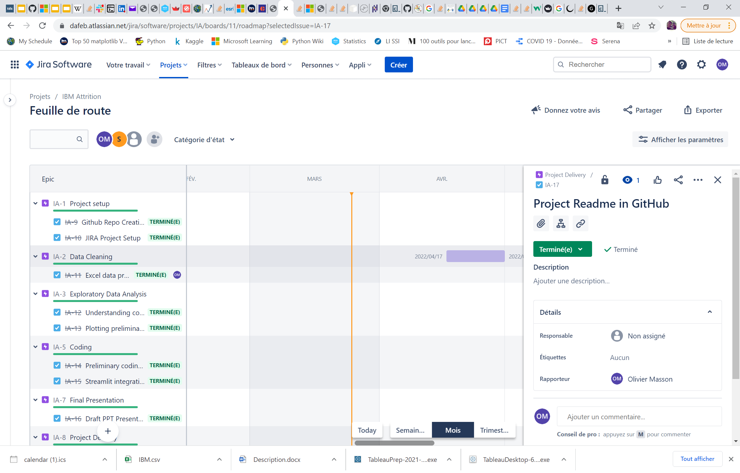
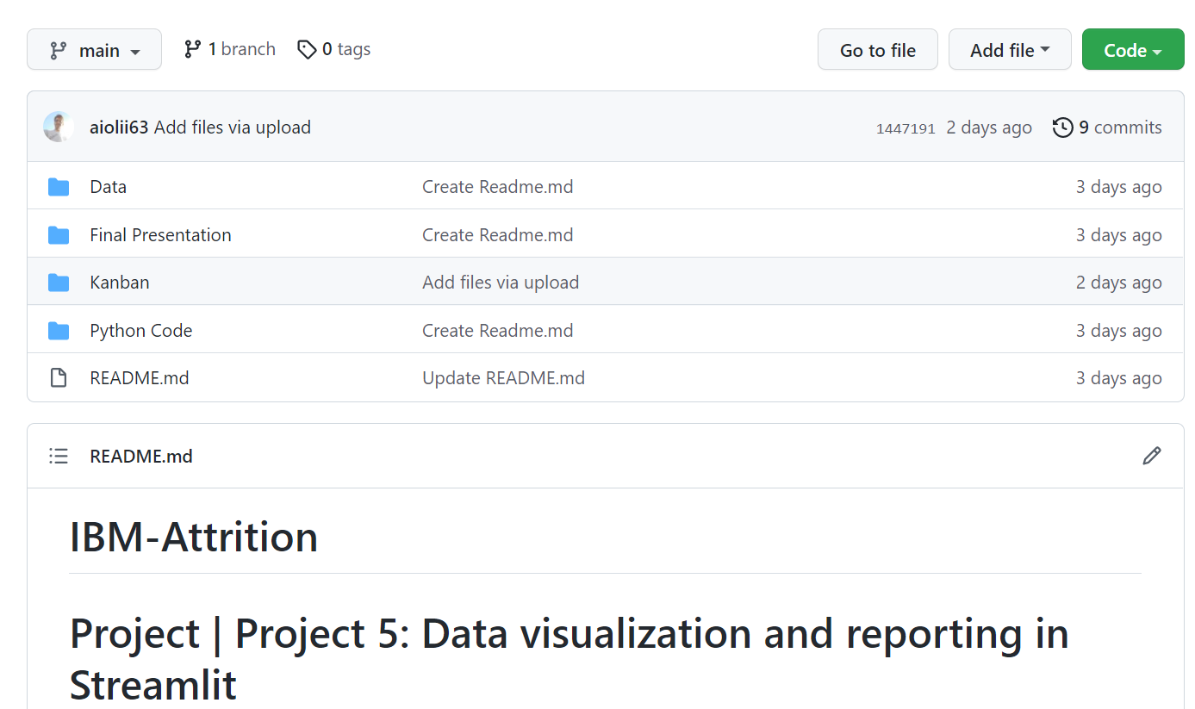
1
Project Initiation
4
Notes:
© 2014 Microsoft Corporation. Tous droits réservés. MICROSOFT N’OFFRE AUCUNE GARANTIE, EXPRESSE, IMPLICITE OU LÉGALE CONCERNANT LES INFORMATIONS DE CETTE PRÉSENTATION.
4
27/03/2022 23:10

Slide 5
OUR PROJECT FRAMEWORK
1
2
3
4
5
Project Initiation
Data Cleaning
Exploratory Data Analysis
Data Visualization
Key Takeaways
5
Notes:
5

Slide 6
2
Our data cleaning summary
BEFORE
Very clean dataset of close to 1.5k rows x 13 columns
Very limited NaN or missing values
AFTER
Low to no information loss
Clean data on each and every employee record
In the Attrition category, we coded 1 as Leavers, 0 as Stayers
6

Slide 7
OUR PROJECT FRAMEWORK
1
2
3
4
5
Project Initiation
Data Cleaning
Exploratory Data Analysis
Data Visualization
Key Takeaways
7
Notes:
7

Slide 8
3
Our data dictionary
NUMERIC DATA
Age: Age of employee
DistanceFromHome
MonthlyIncome
NumCompaniesWorked: Number of companies worked prior to IBM
YearsAtCompany: Current years of service in IBM
CATEGORICAL DATA
Attrition: Employee attrition status
Department: Department of work
Education: 1-Below College; 2- College; 3-Bachelor; 4-Master; 5-Doctor;
EducationField
EnvironmentSatisfaction: 1-Low; 2-Medium; 3-High; 4-Very High;
JobSatisfaction: 1-Low; 2-Medium; 3-High; 4-Very High;
MaritalStatus
WorkLifeBalance: 1-Bad; 2-Good; 3-Better; 4-Best;
8

Slide 9
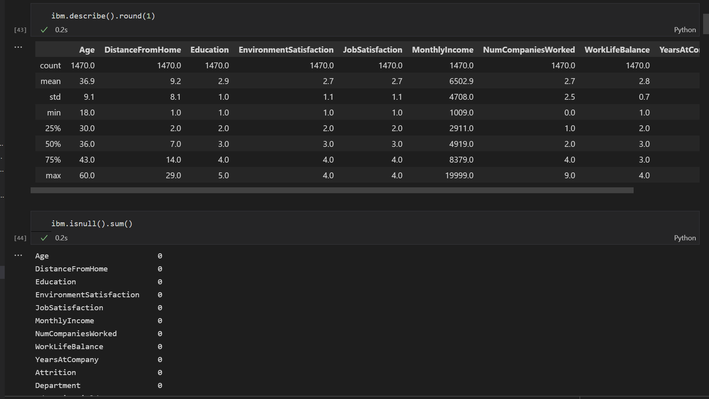
3
Exploratory Data Analysis code sample
9

Slide 10
OUR PROJECT FRAMEWORK
1
2
3
4
5
Project Initiation
Data Cleaning
Exploratory Data Analysis
Data Visualization
Key Takeaways
10
Notes:
10

Slide 11
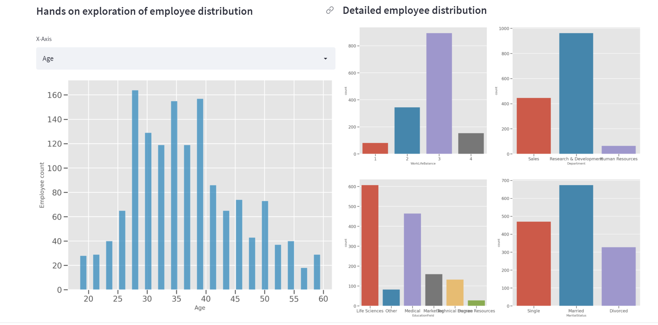
4
Streamlit: a very powerful tool to prototype our data app

Slide 12
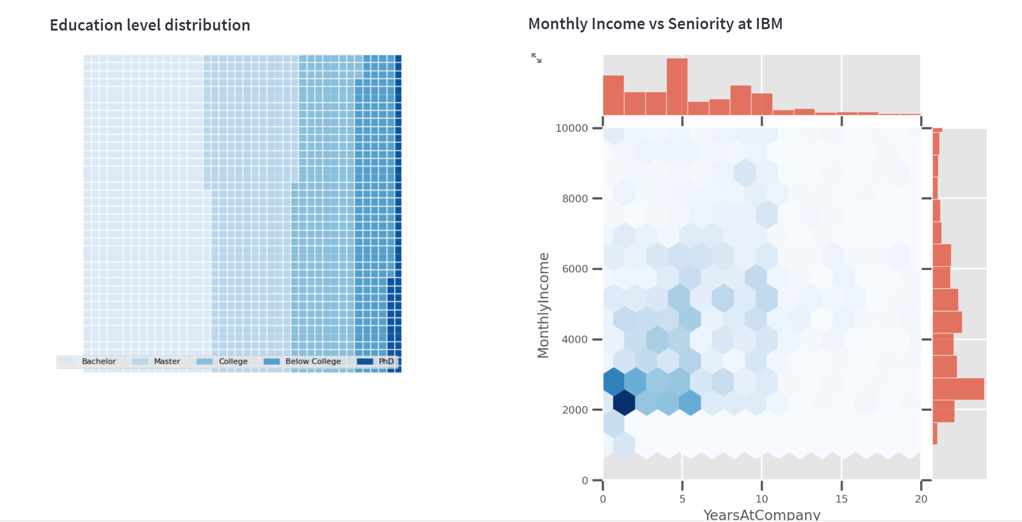
4
Data exploration made easy

Slide 13
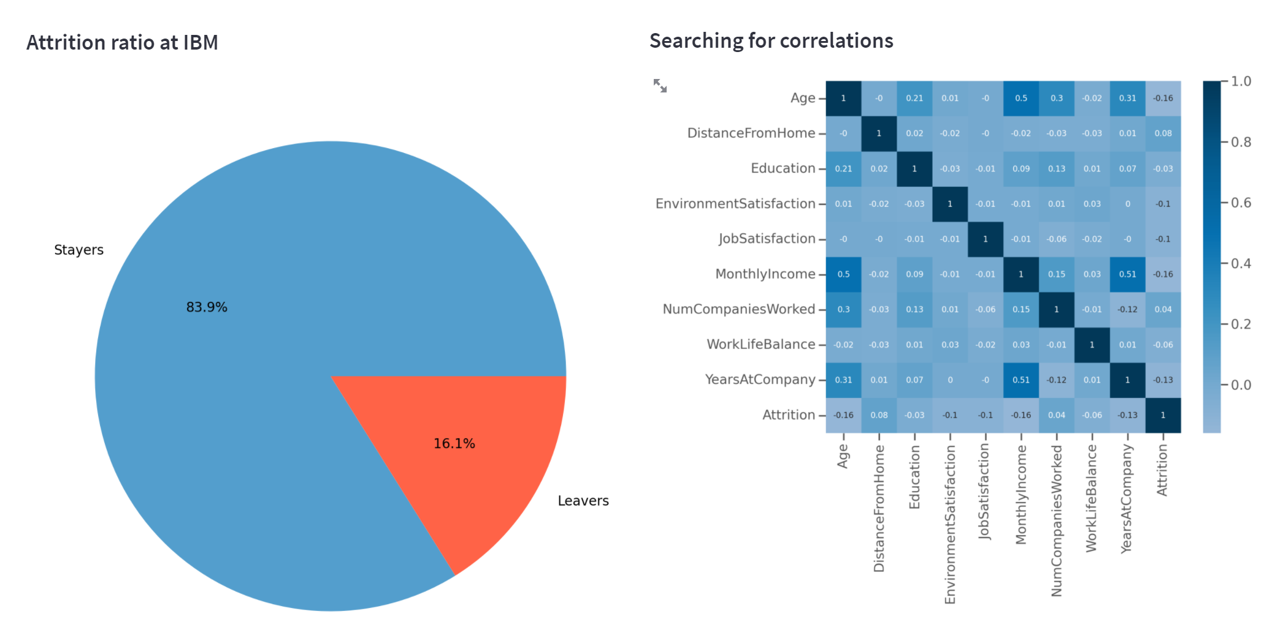
4
Focus on attrition

Slide 14
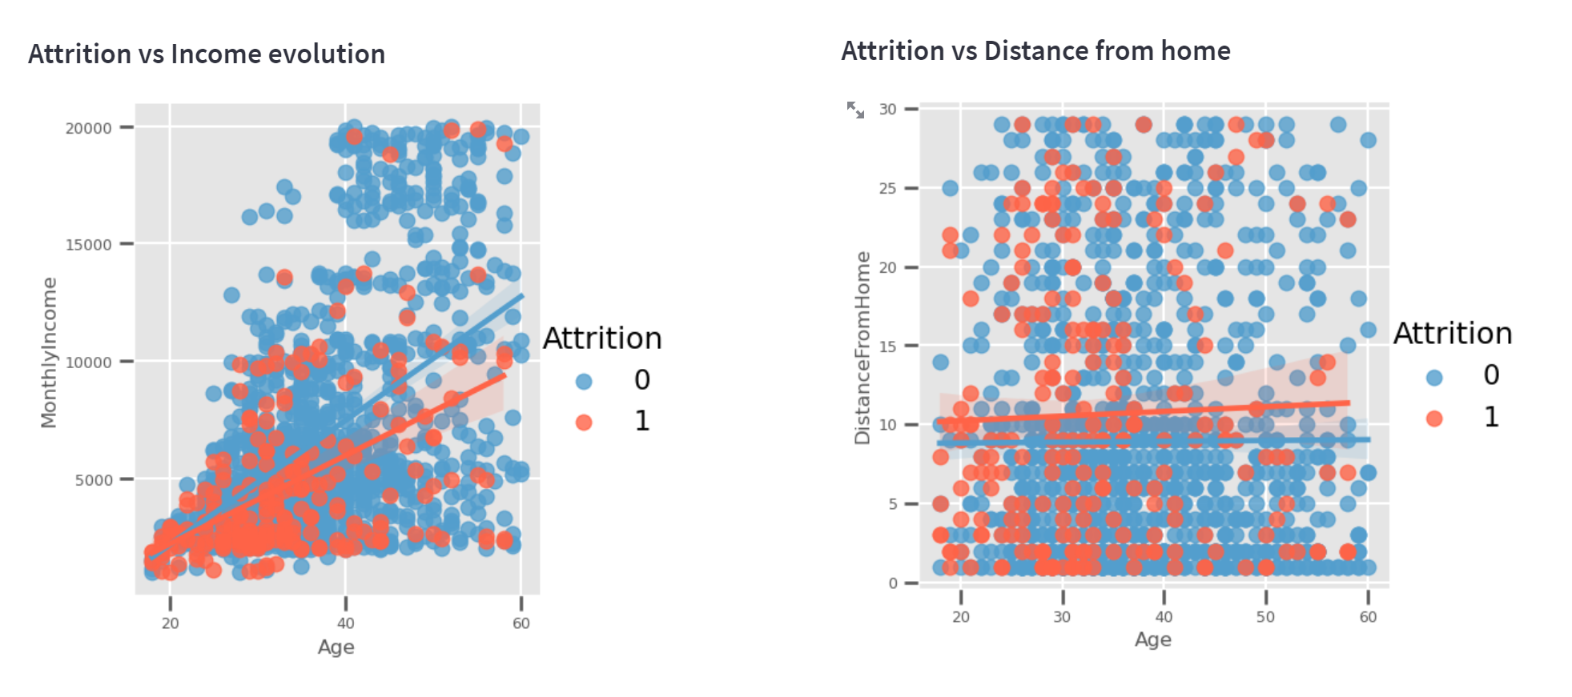
4
2 key variables to understand and explain attrition at IBM
https://ibm-attrition.herokuapp.com/

Slide 15
OUR PROJECT FRAMEWORK
1
2
3
4
5
Project Initiation
Data Cleaning
Exploratory Data Analysis
Data Visualization
Key Takeaways
15
Notes:
15

Slide 16
5
Key Takeaways
What we know so far: Income Evolution and Distance from Home are key variables to test in order to better understand reasons for attrition
We would have liked to have Gender as part of the dataset
We would have liked to get Time Series to understand trends through various years

Slide 17
NEXT STEPS
Integrate more Streamlit controls to make data discovery dynamic
Integrate time series data to get a feel for changes thourgh time
Test probability of leaving IBM vs certains criteria (distance from home, income evolution…)
Notes:
17

Slide 18
QUESTIONS ?
18
Notes:
Combinez une image et plusieurs instructions clés avec une grille forte.
18

